Slide 1
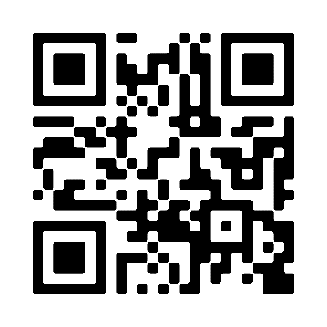
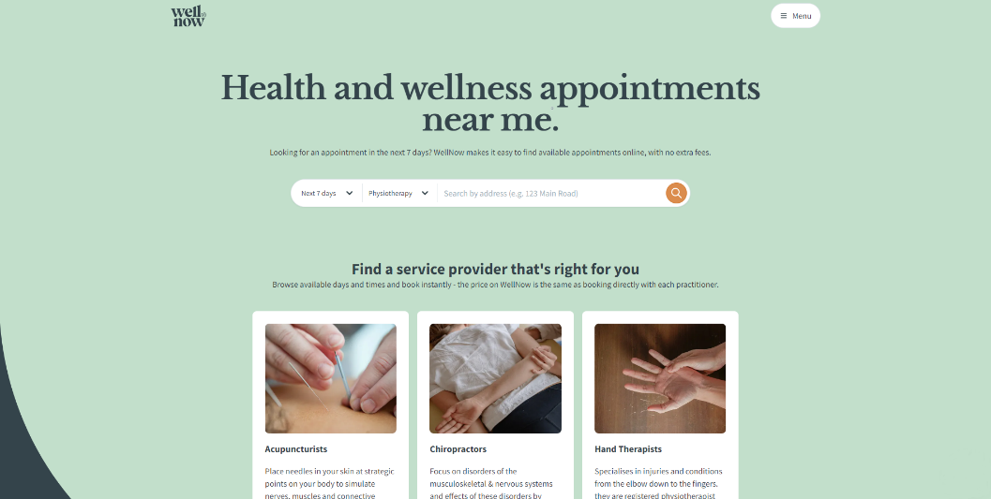
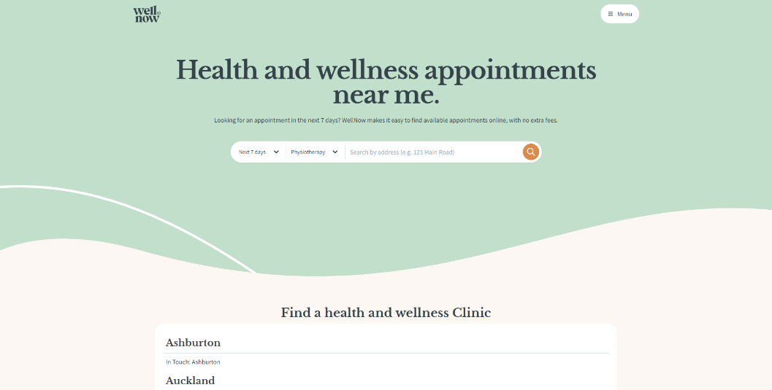
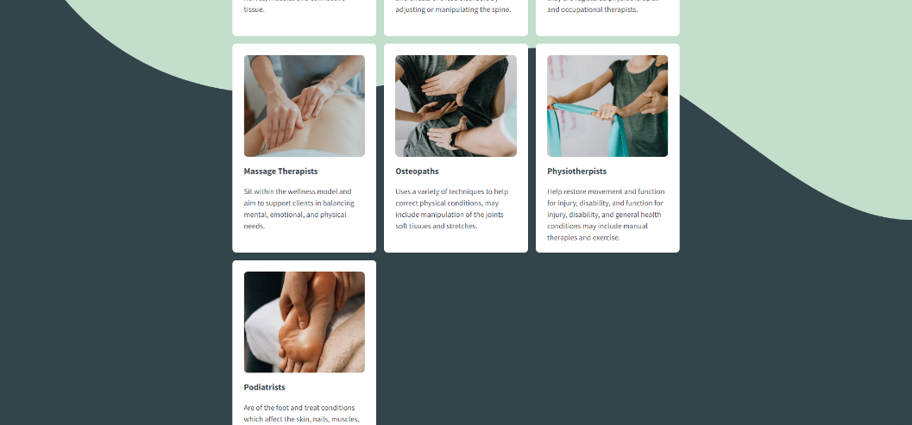
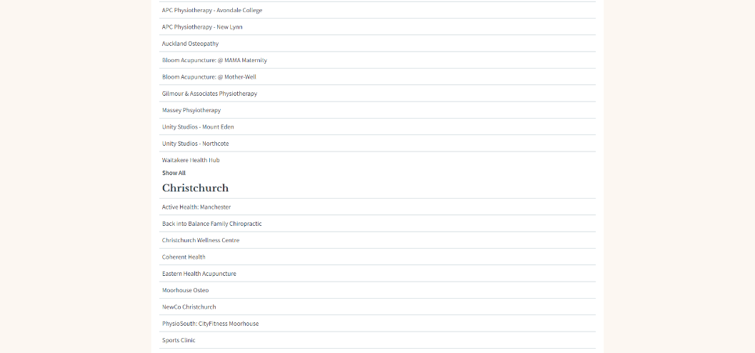
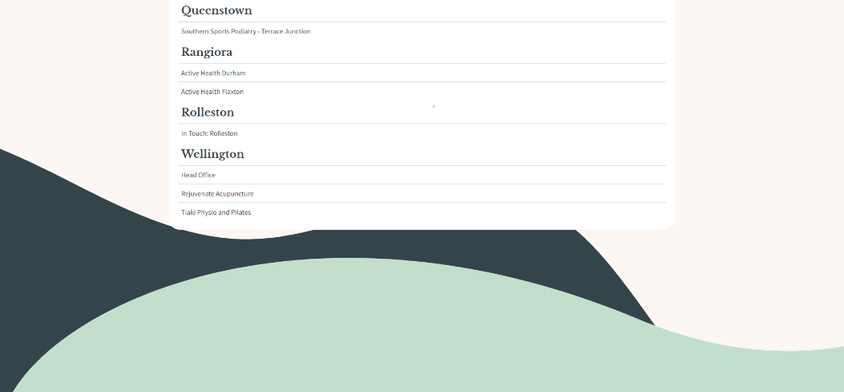




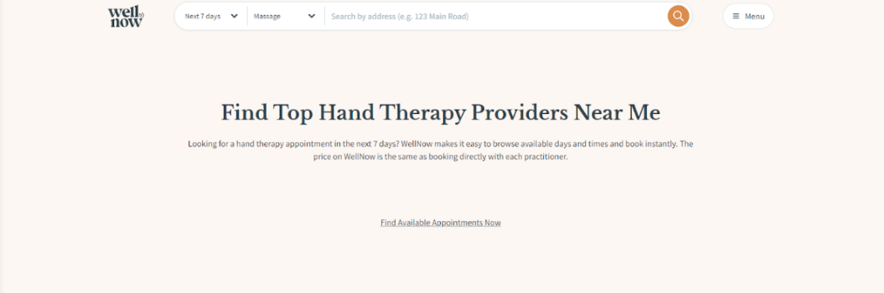
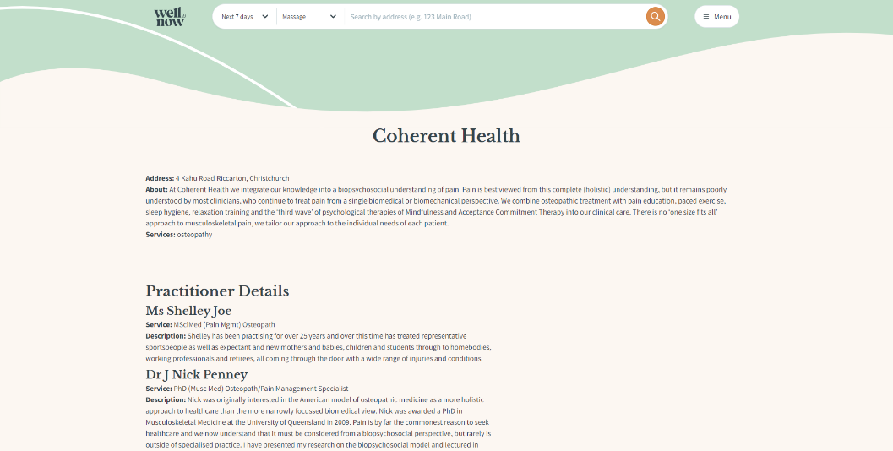

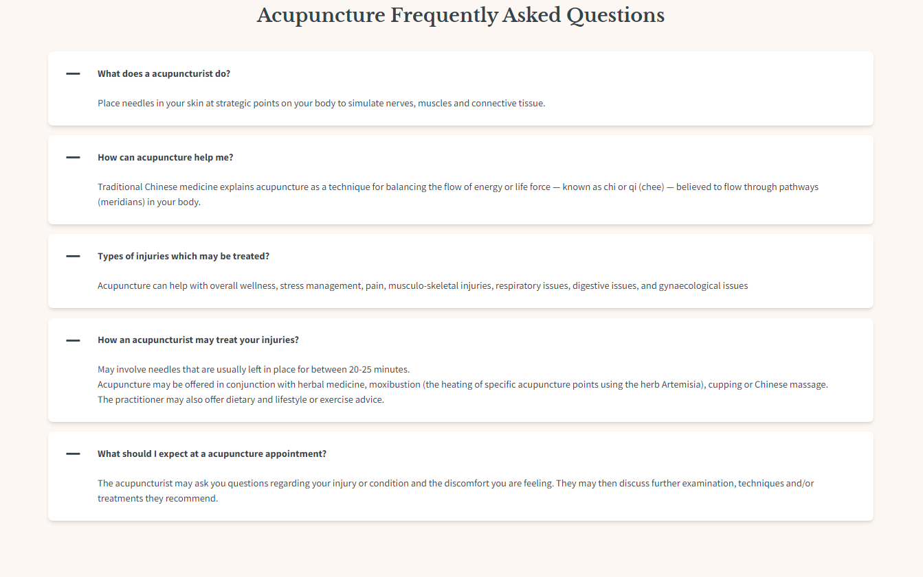
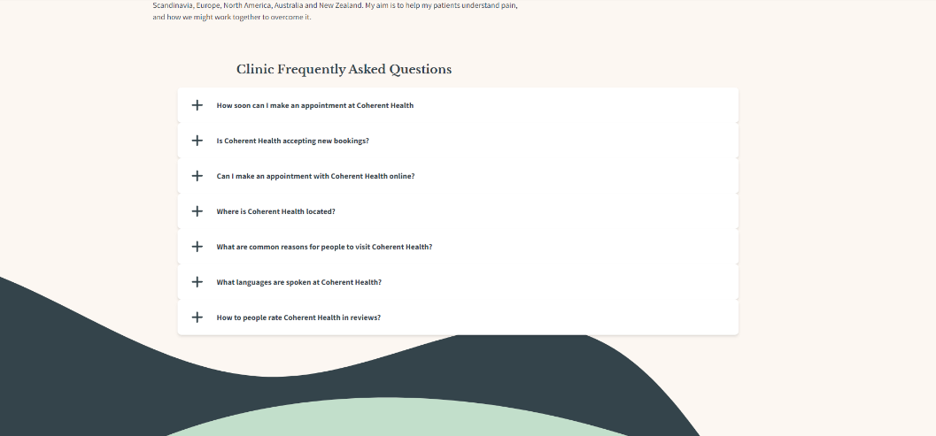


Medical Appointment Booking Solution Brock Winter, Bachelor of Information & Communication Technologies, Ara Institute of Canterbury - Te Pūkenga, 2023 Sem 2 brocklordwinter@gmail.com
The Project
Together with WellNow, a business that helps people find last minute appointments with numerous different clinics we focused on Improving Search Engine Optimisation to increase the amount of traffic to the website. To do this we wanted to increase the number of content pages on the website.
What Happened
Results / Outcomes
Utilising many technologies, languages, and concepts multiple pages were created in React. There where two sets of pages created. The first set was for the services offered where there was a page that displayed all services and from that page you could go to find out more about a specific service offered at WellNow.
The second set of pages was for clinics. The main page showed a list of clinics grouped by city. From that page you could find out more information about an individual clinic. This information showed what services they offered and who the practitioners are that work there.
We enabled more clinics to display available appointments by creating two APIs that connected to online booking sites Setmore and Nookal.
The result was the creation of multiple webpages that increase the sites content allowing the Google Search engine to better recognize WellNow as a more substantial website.
Figure 1
Services Page
Figure 2
Clinics Page
Tools Used
Figure 3
Individual Services Page
Figure 4
Selected Clinics Page
React
Learning Outcomes
Coding Languages:
React
Ruby
Json
Typescript
Tailwind CSS
Personal Skills:
Communication
Time management
Problem solving
Flexibility
Quality assurance
Risk management
Methodology
Conclusion
This project used Agile methodology. Agile helps to encourage healthy communication, teamwork, and continuous improvement. It does this by breaking large tasks into smaller more manageable ones. Notion which is a Kanban board was also used. There were also weekly scrum development team meetings that enabled the participants to share their status on the project [2].
This project allowed me to challenge myself, learn new technologies, and skills from talented individuals. This project was a valuable experience that will help me on my development journey in the future.
Acknowledgements
References
Course Convenor : Dr David Weir david.weir@ara.ac.nz
Academic Supervisor : Robert Oliver Robert.oliver@ara.ac.nz
Industry Supervisor : Henry Maddocks
[1] https://wellnow.nz/
[2] https://www.wrike.com/agile-guide/agile-development-life-cycle/

